Slide 1


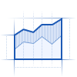

Integrity adversary
Label flipping
Feature poisoning
0
1
T₁
T₂
T_{K}
Accepted
Benign
Attack
Sequential domains
Generative replay
Zero Trust Verifier
Classifier
Rejected
Privacy-preserving generative replay
Clip gradients
Add Gaussian noise
Update generator

